Slide 1
PERFECTED BY JESUS CHRIST ONCE AND FOR ALL

Slide 2
CORNELIUS A DEVOURED MAN OF GOD

Slide 3
HOW WE BECAME SINNERS

Slide 4
Through adam all sinned,romans 5:12

Slide 5
OUR SINFUL NATURE
We are sinners not because of what we have do but because sin is in us
sweet kind
happy good
generous loving
No matter what we do we cannot save ourselves because
It is not by our works
It is not by our good doing
It is not by obeying the law for the law is to show us how sinful we are
BUT IT IS THROUGH JESUS CHRIST

Slide 6
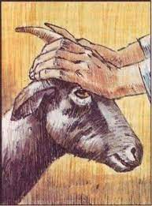
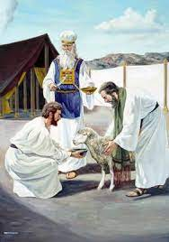
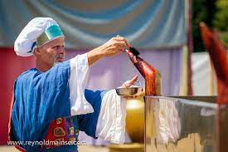
Without the shedding of blood there is no remission
HOW WE WERE SAVED FOREVER SACRIFICE
In the olden days,a lamb without blemish was used , Leviticus but how long can it save us
Everytime Every month Every year Forever
JESUS CHRIST HAS WASHED US WITH HIS BLOOD ONCE AND FOR ALL,HEBREWS 9:22

Slide 7
THE BLOOD OF JESUS CHRIST SAVES US ONCE AND FOR ALL
The wedges of sin is death , we are suppose to die but God sent Jesus Christ to come and die for us.
John3:16 and Hebrews10:17

Slide 8
What do you believe ?
Jesus Christ who was able to take away all your sins or Jesus Christ who took some of your sins away?
IF YOU BELIEVE YOU WILL BE SAVED
Hebrews 10:14,once and for all
AMEN!!!

